Slide 1
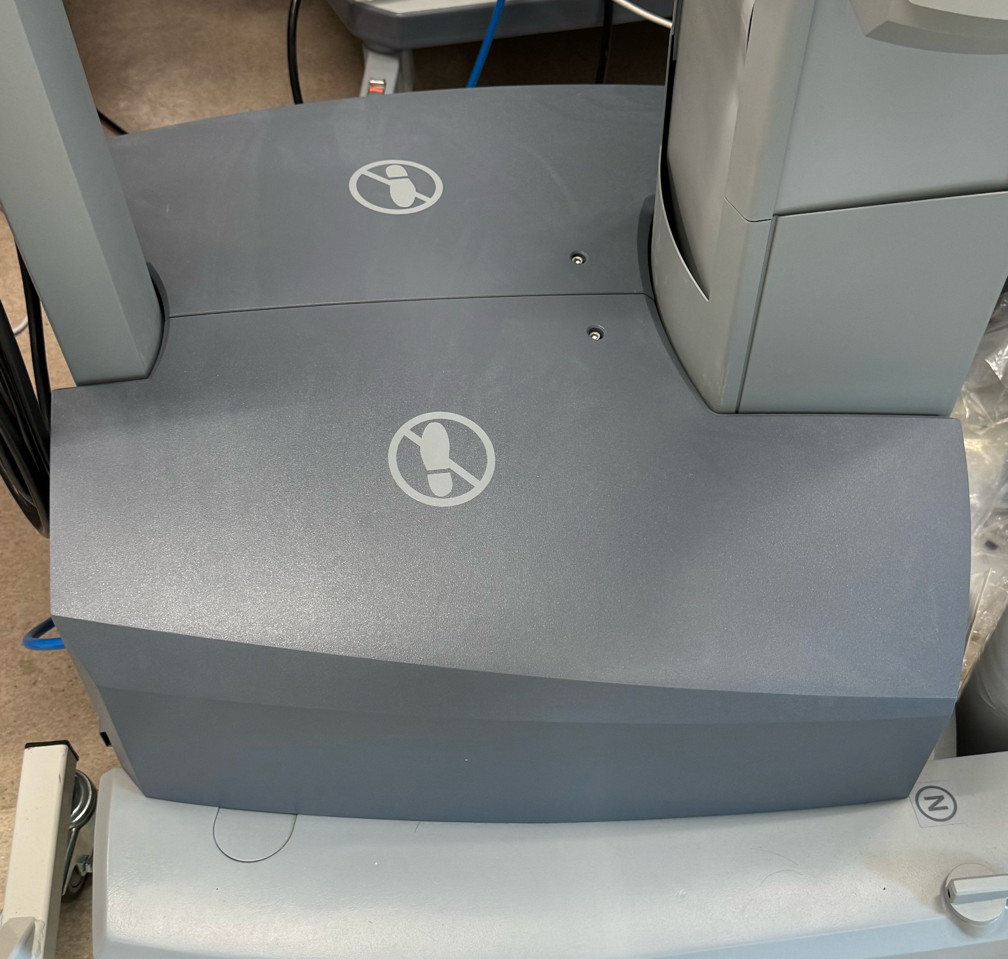
3/16th hex screws
Remove 2 hex screws (3/16 allen wrench)

Slide 2
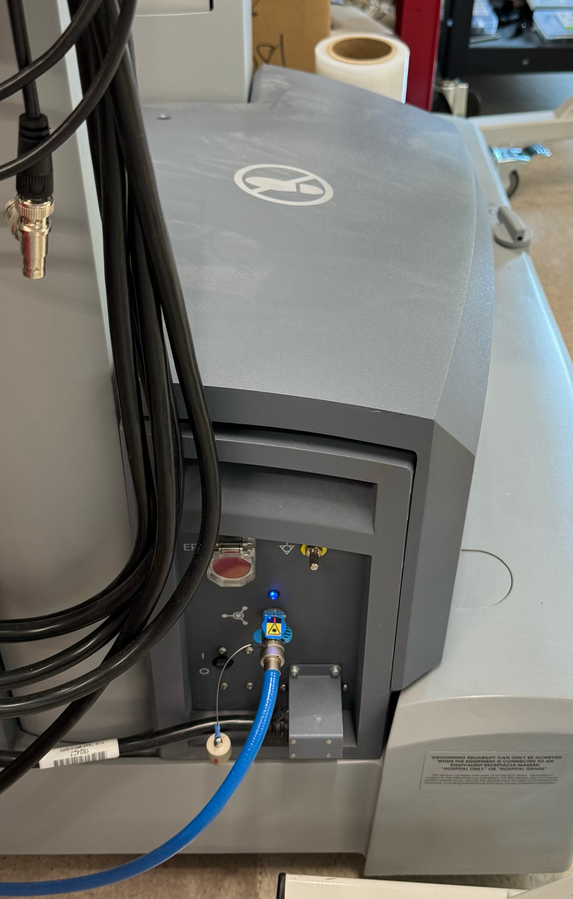
Use friction of palm to pull up the plastic cover. Remove both covers.
It requires a lot of force.

Slide 3
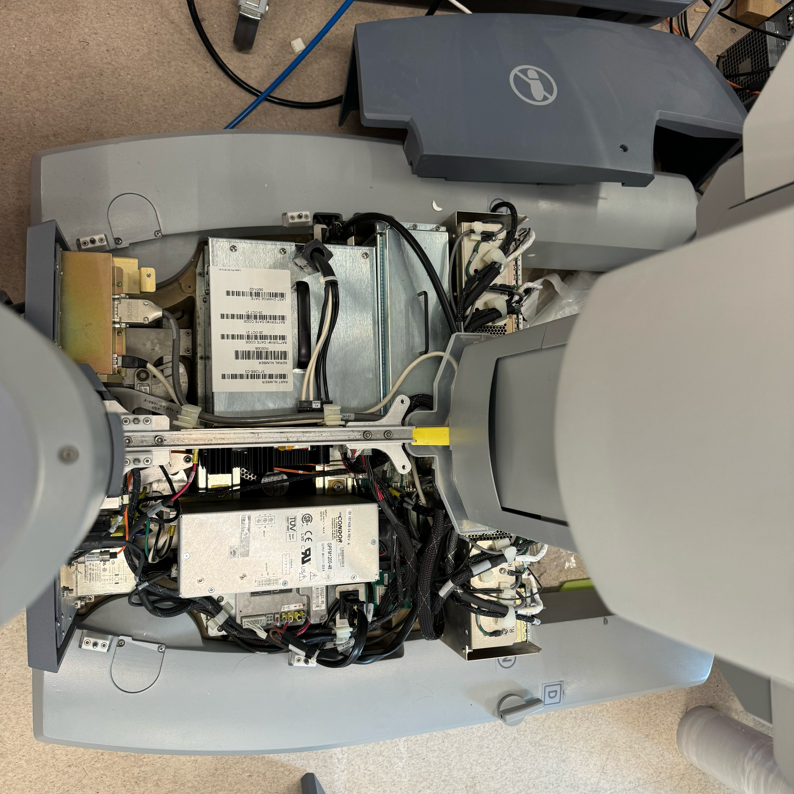
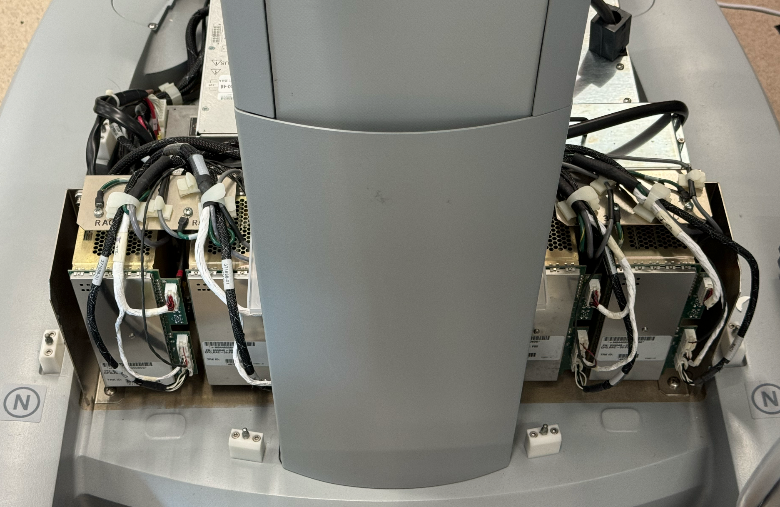
RACs
Bracket
Back panels
“Shoulders”
Cover
“SJA2”
PSM2
“SJX”
PSM3
“SJC”
ECM
“SJA1”
PSM1
Internals. Remove everything except cables in the next slides.
Remove back panel.
Remove brackets/covers (red arrow) if needed.

Slide 4
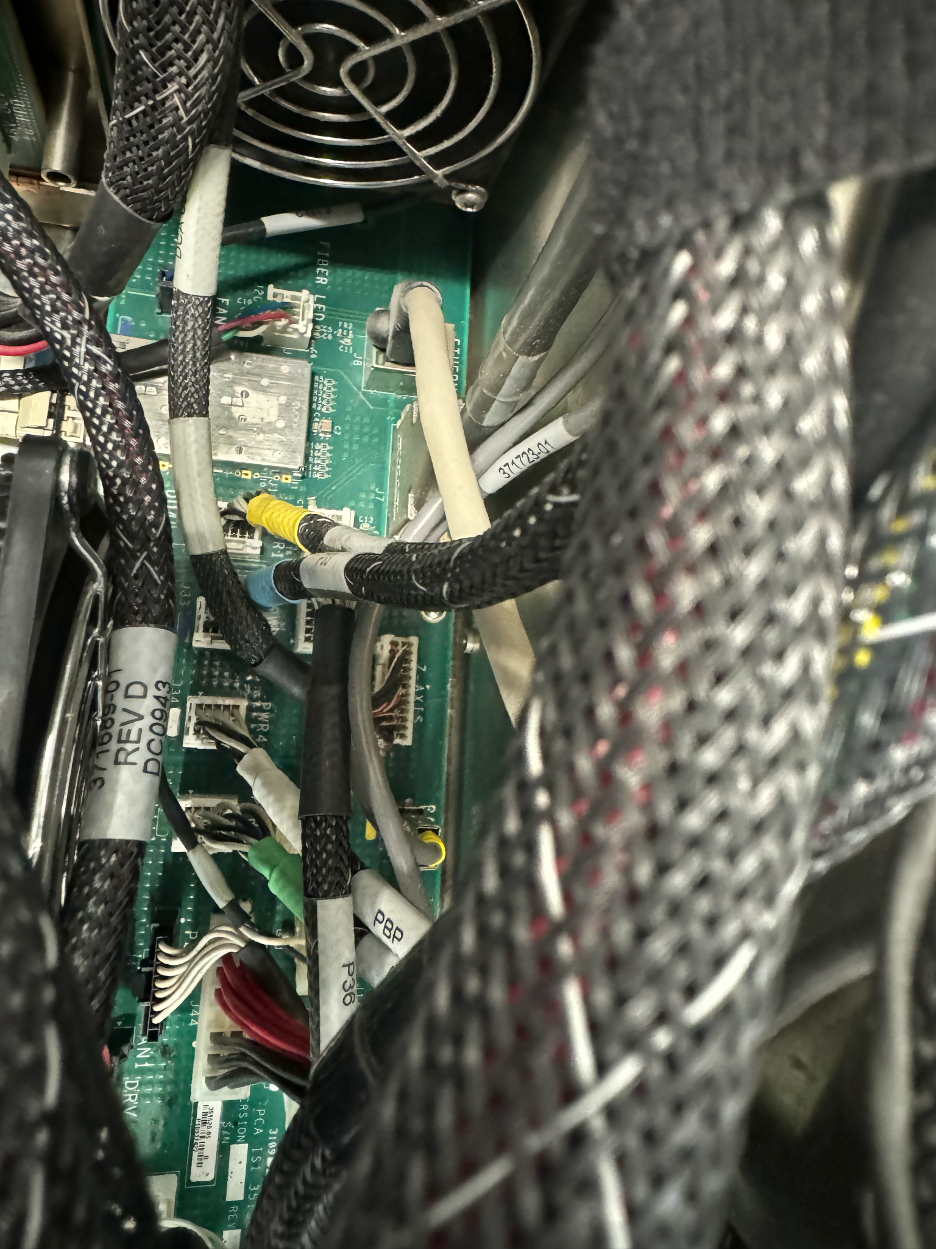
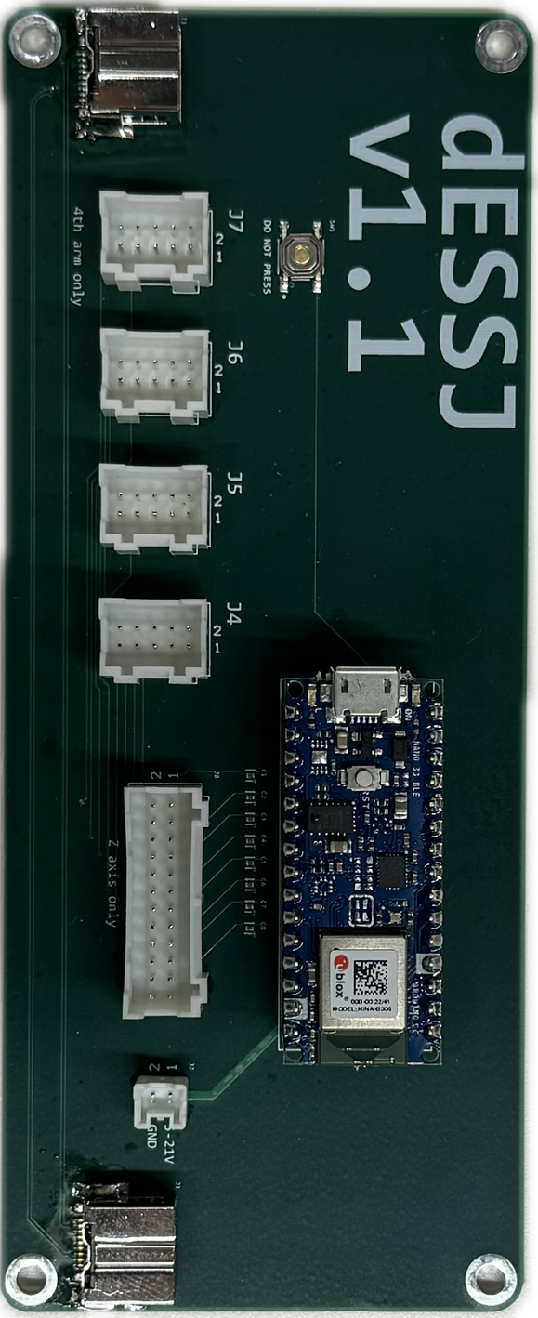
“Z-AXIS”
Preserve
Unplug and preserve the cable labeled “Z-AXIS”. Squeeze the tab and pull.
Plug it into “Z axis” connector in a dESSJ. This dESSJ does not need any other connection except for USB power.

Slide 5
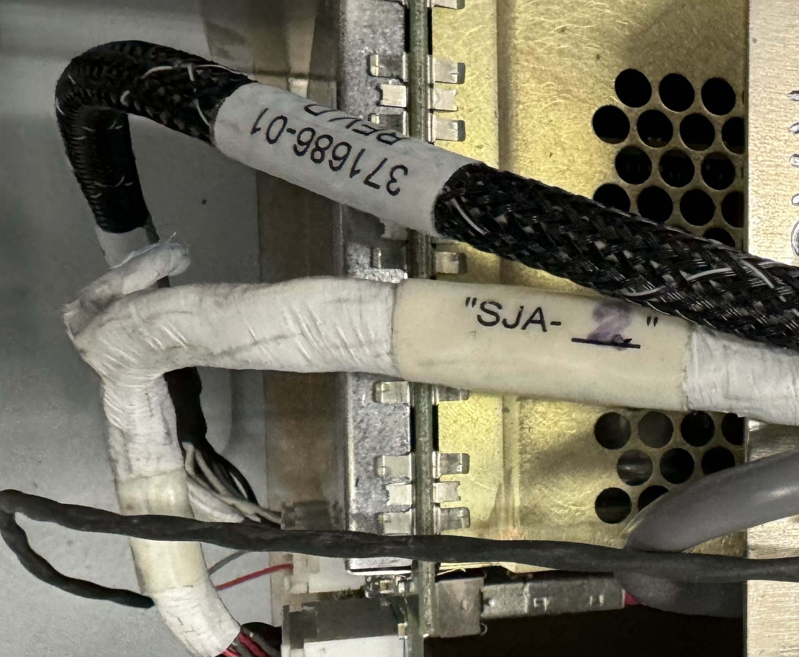
Make sure you know which RAC the cables are unplugged from. bundle and label them with the name of the arm. Some of the cables already have labels on them. See left image for mapping to robot arm names.
From each RAC, you should get
a large bundle of cables with 3 white rectangular connector + 1 “firewire” connector + 1 grounding wire with ring terminal, and
a small 2-wire cable with a white rectangular connector. Keep track of which RAC/arm this cable belongs to.
Pay attention to the 4 RACs (red arrow). Carefully unplug and label cables from them. See next slide.

Slide 6
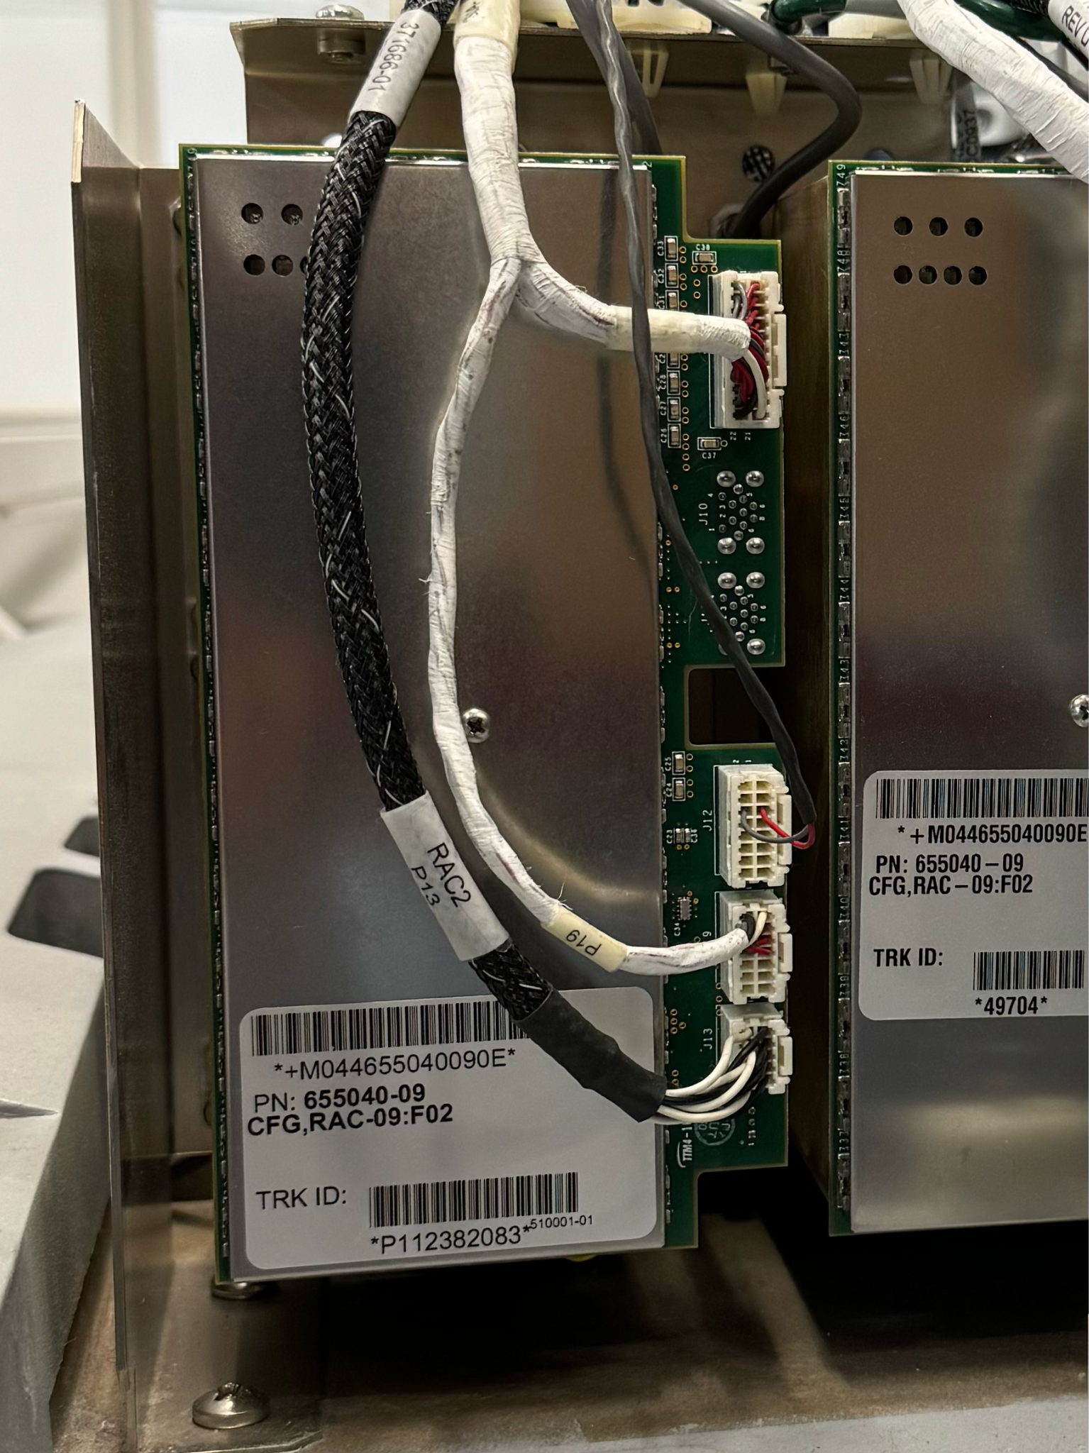
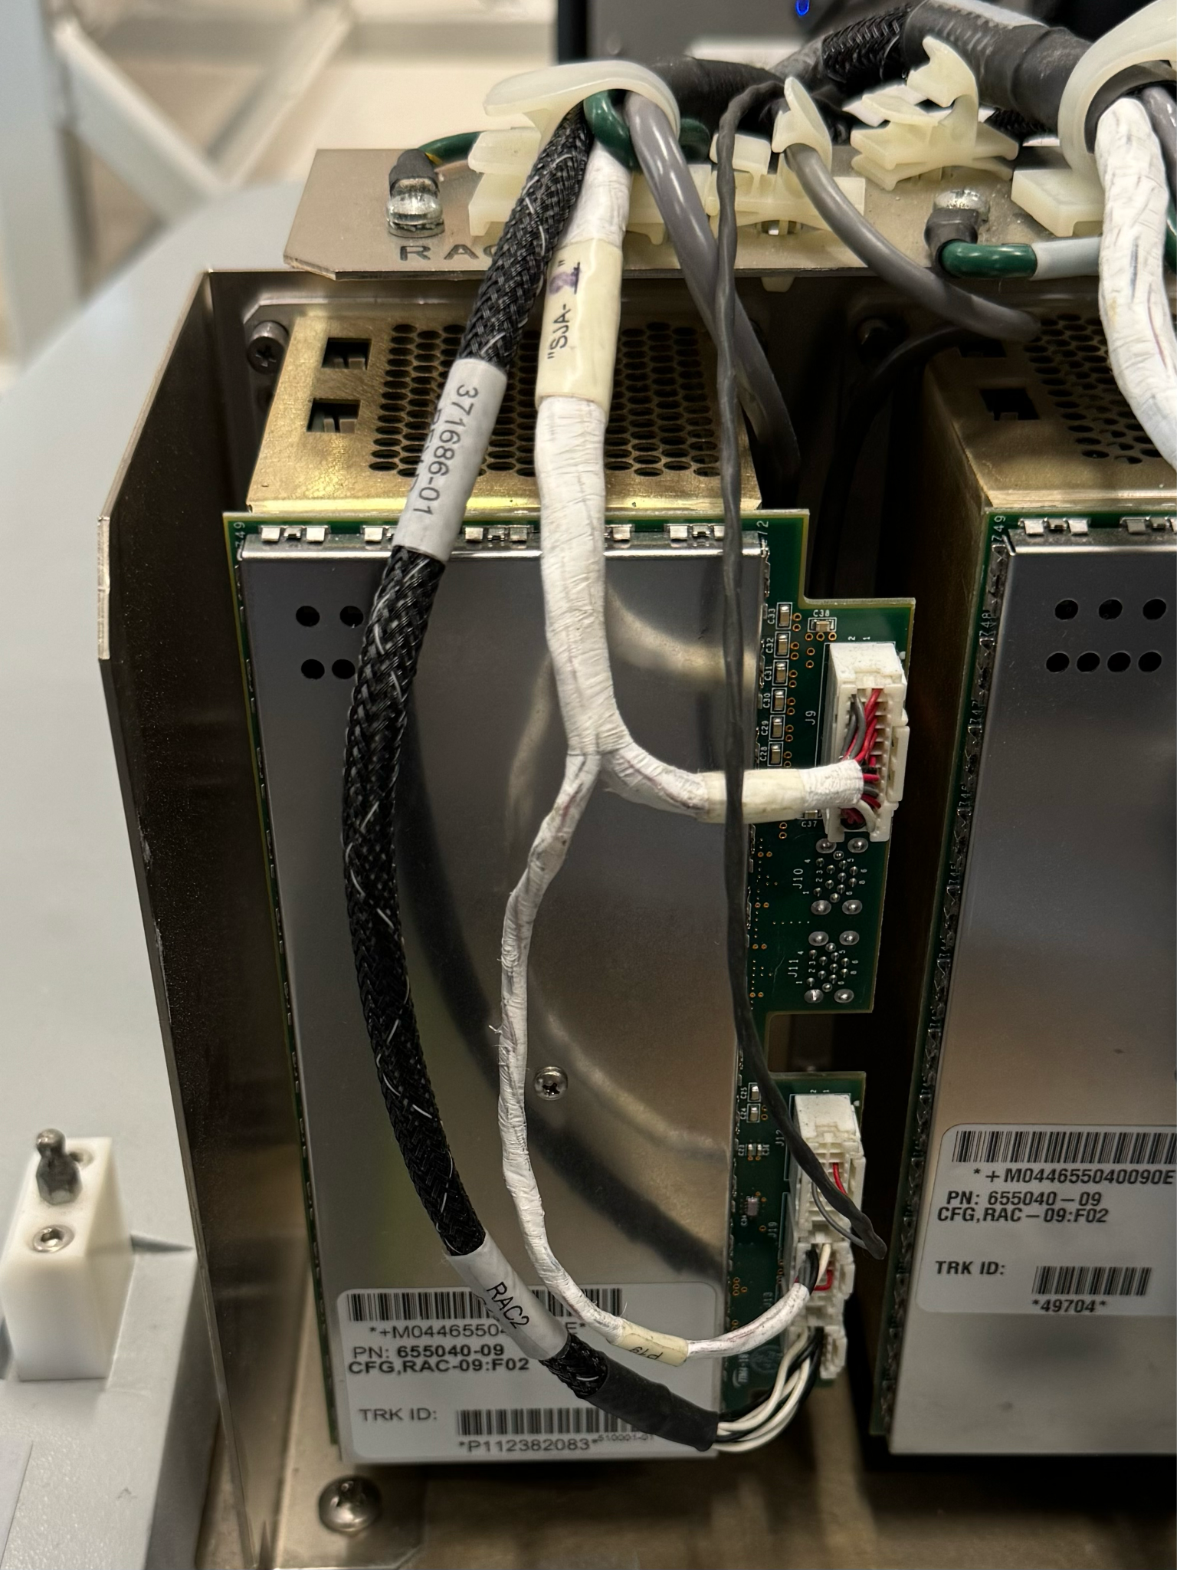
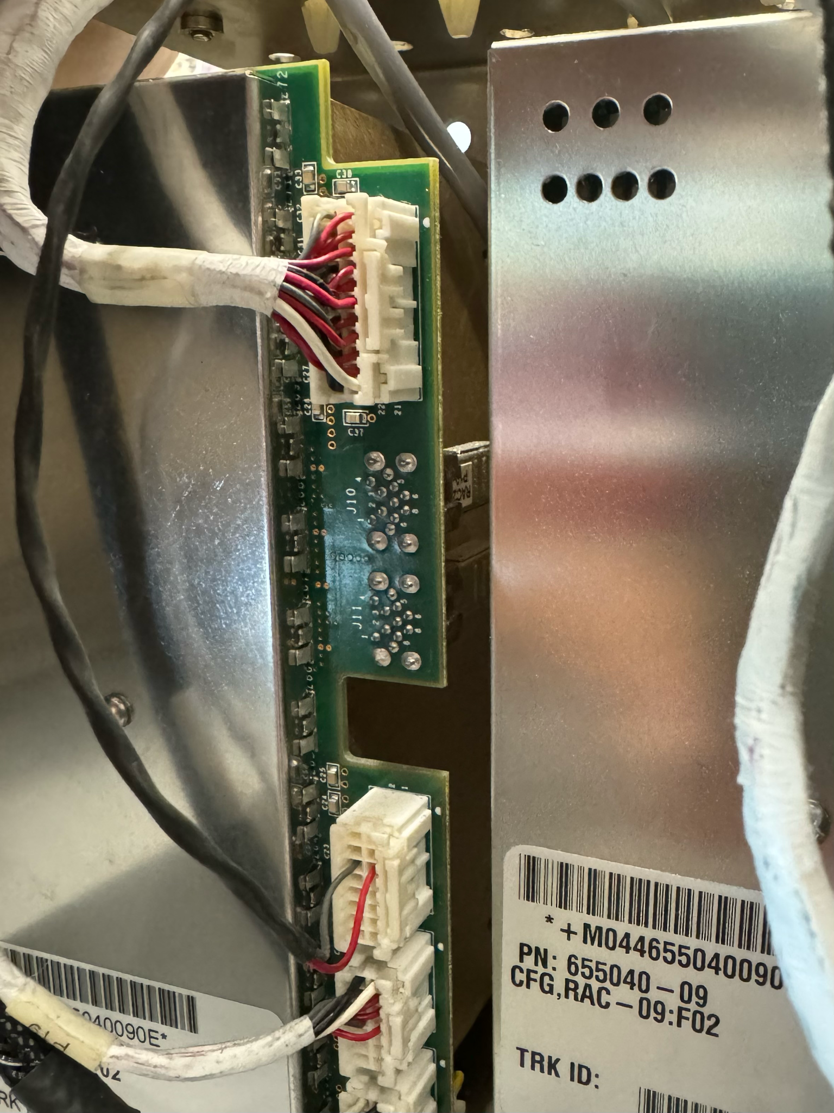
FireWire LVDS on J11
2-wire cable
SJA2 bundle from column
Ground ring connector
3x in the front
1x ring terminal on the top
1x “firewire” in the back. J11. Remove RAC from the giant sheet metal plate before unplugging this cable to avoid damage to the connector.
Unplug and preserve cables from RAC. No need to label individual cables. They are all different.

Slide 7
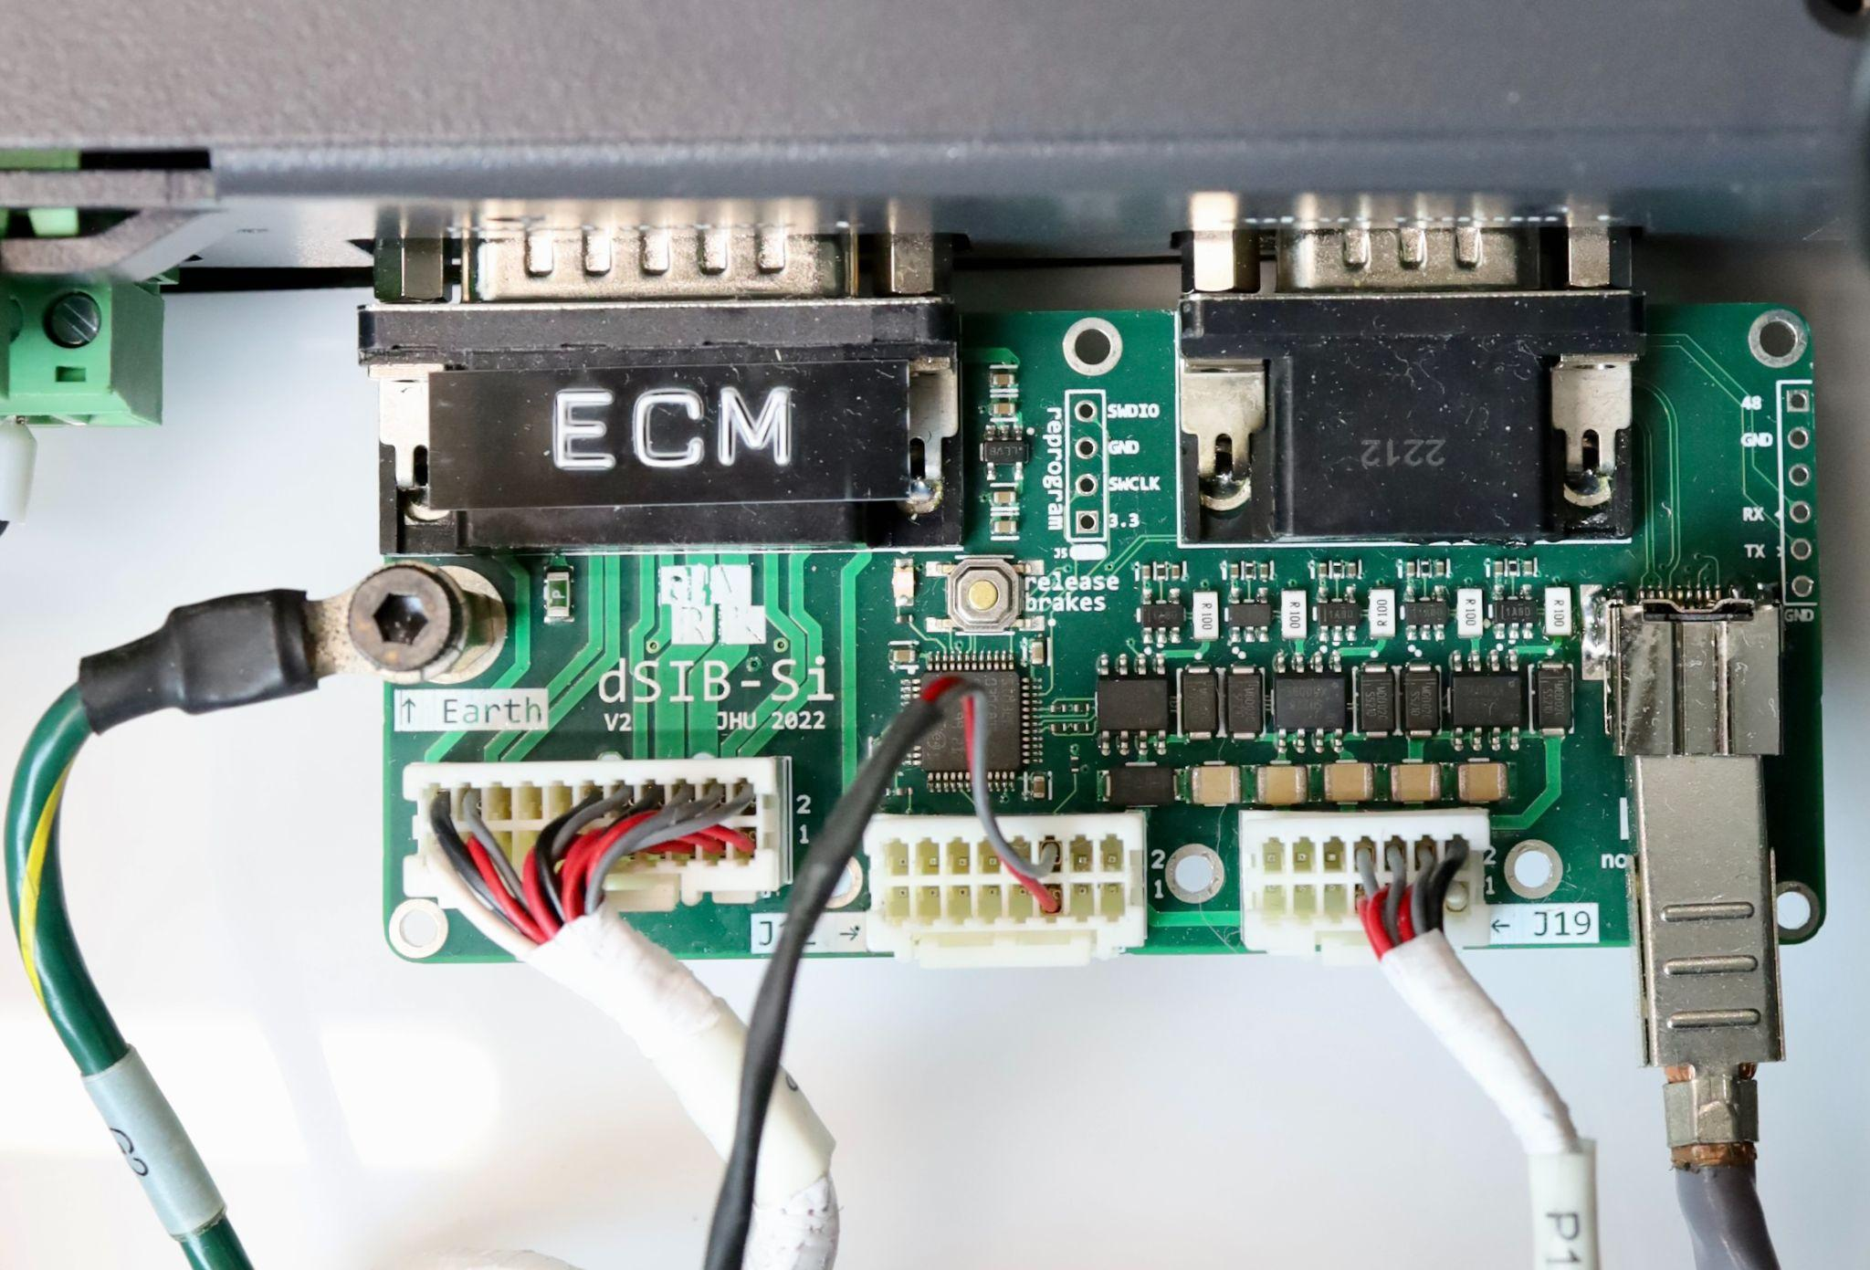
SJA2 RAC
PSM2 dSIB
Preserve
Plug the cables into dSIB-Si

Slide 8
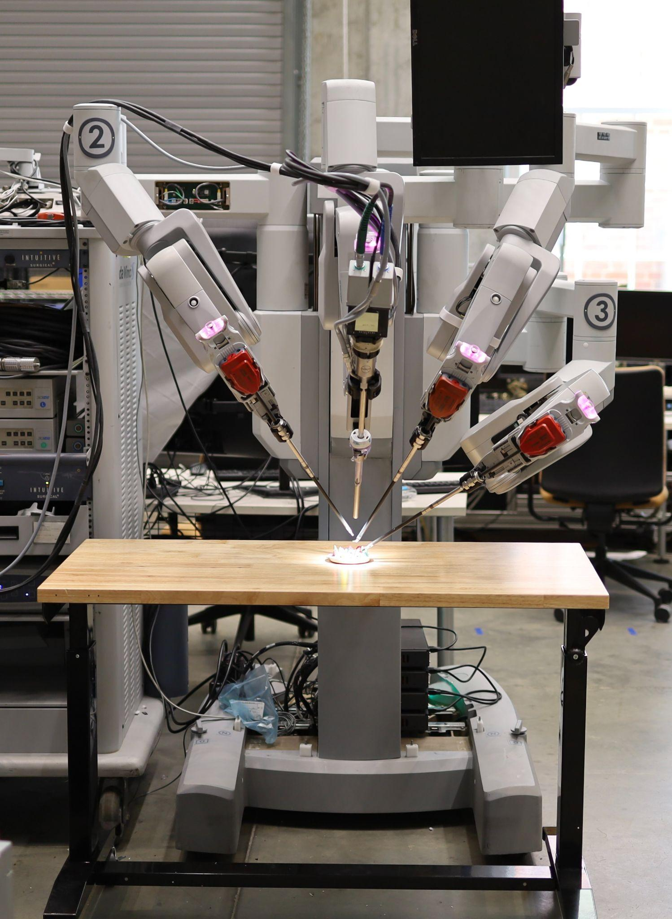
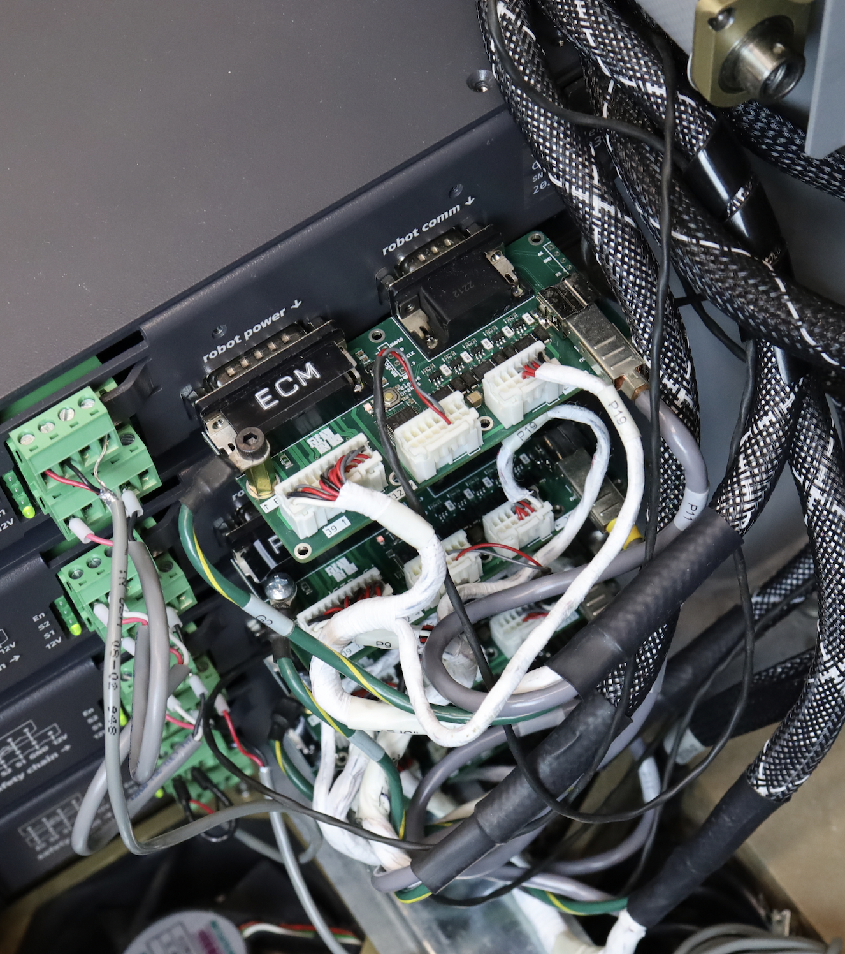
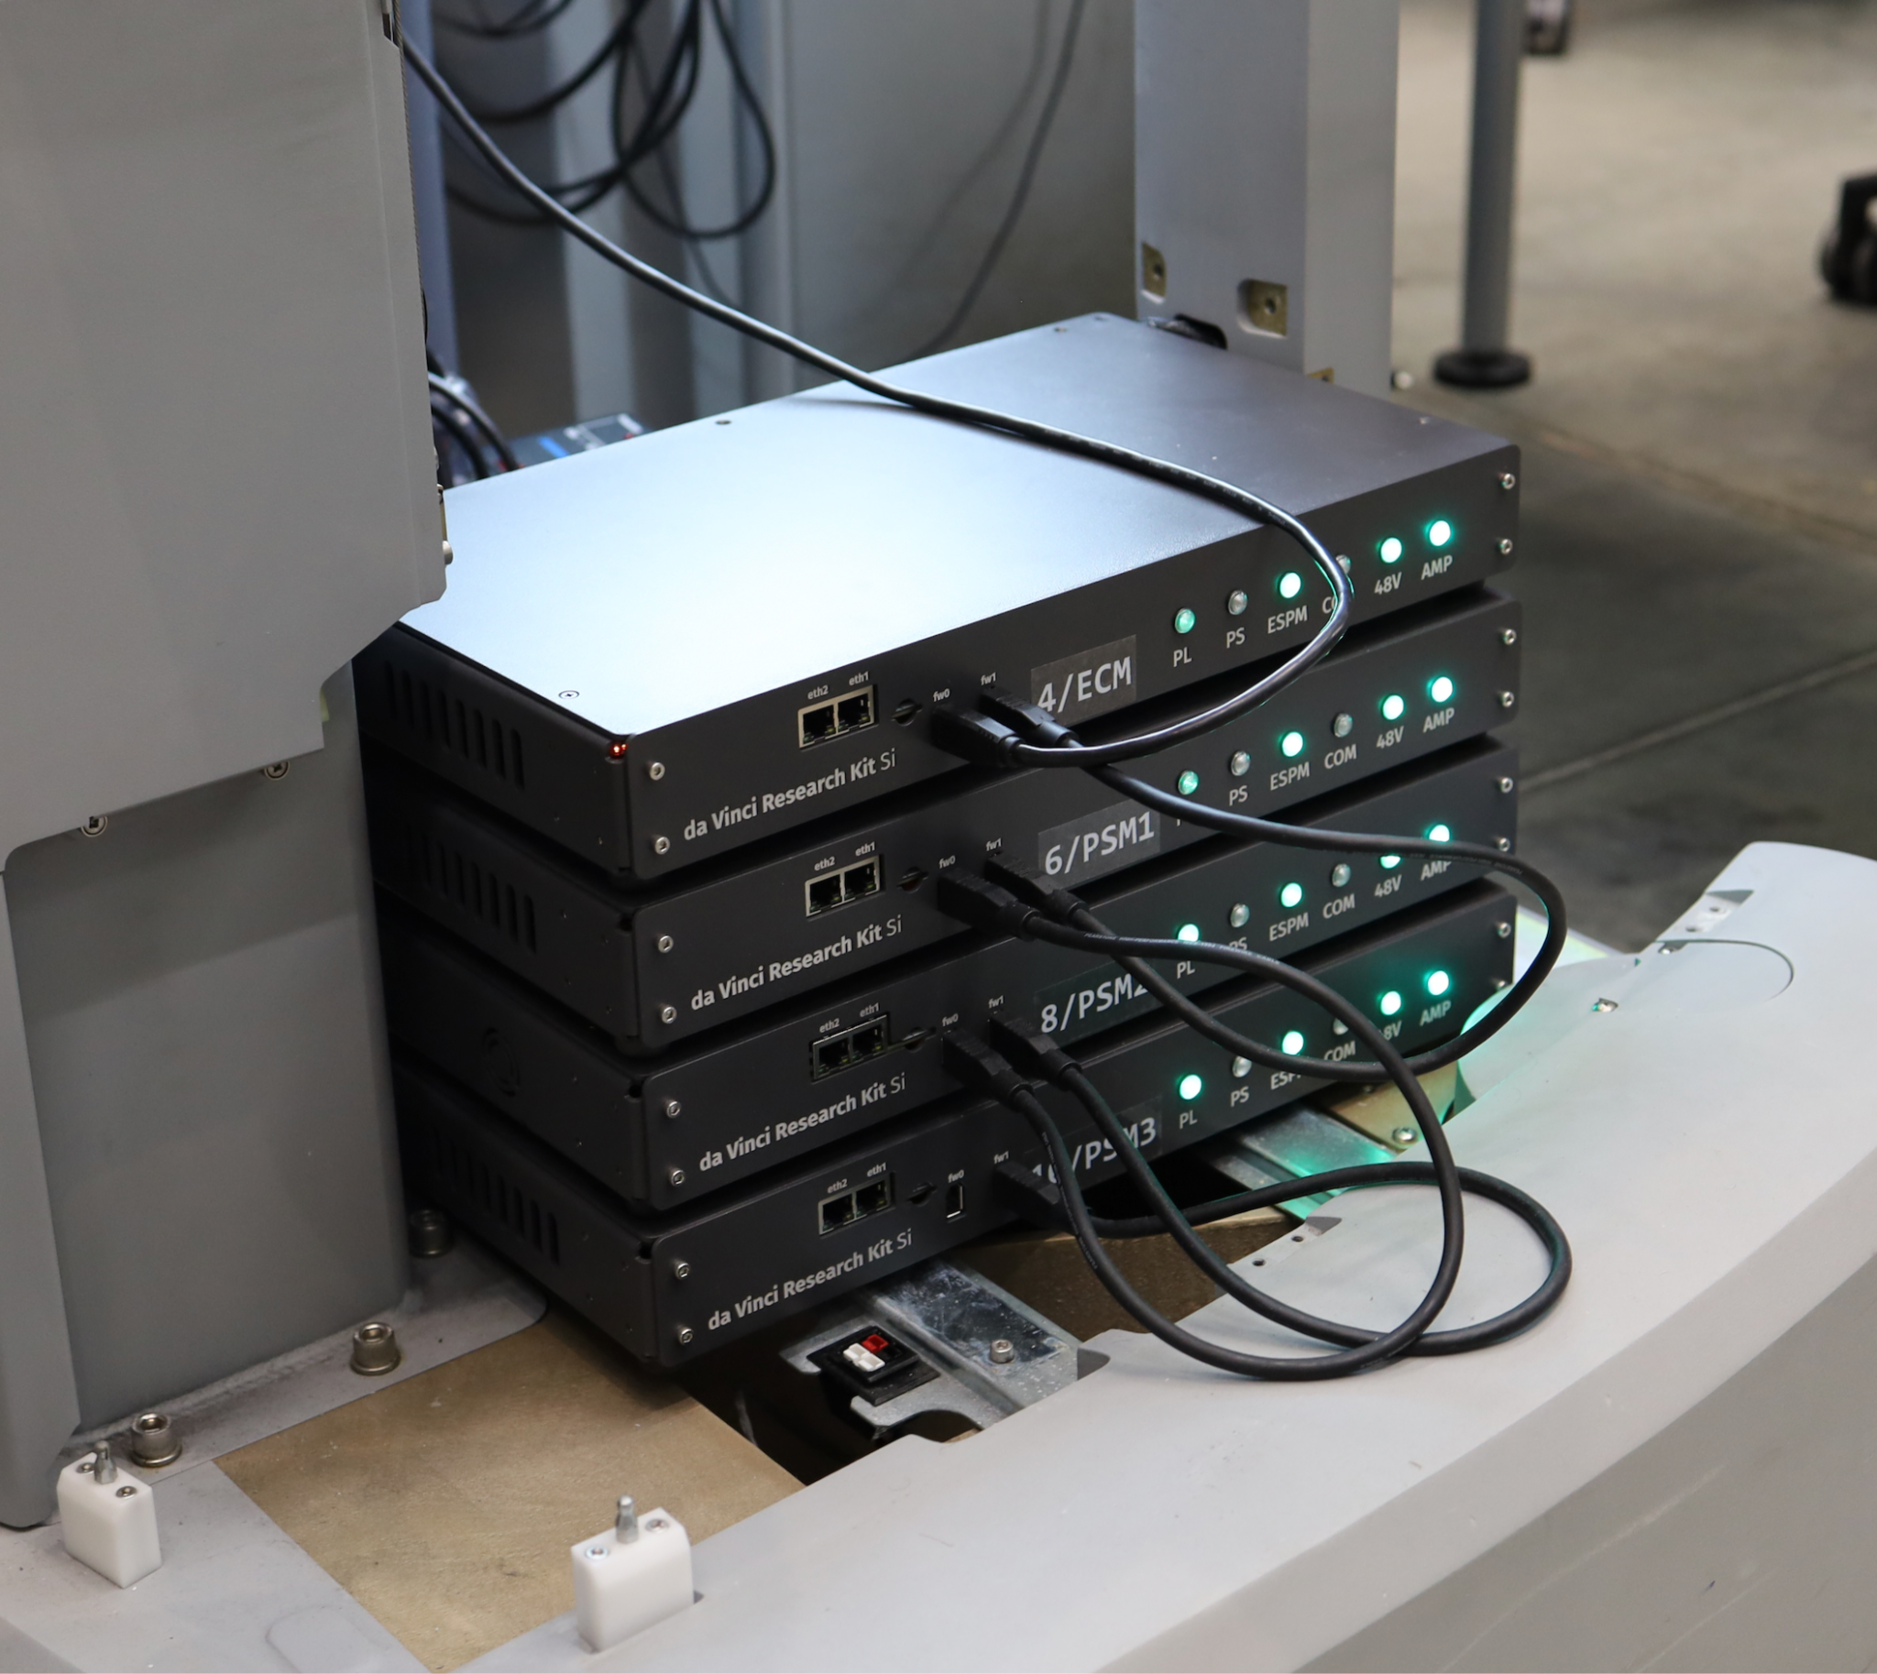
Stack the controllers in the gutted SUJ. Plug in the dSIB-Si

Slide 9
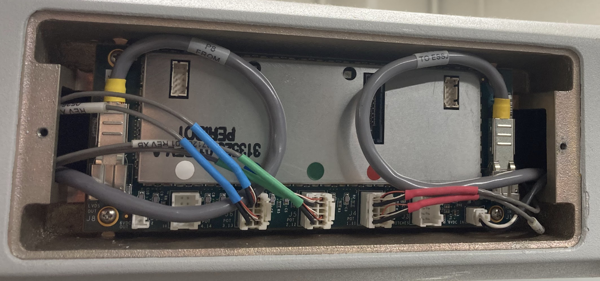
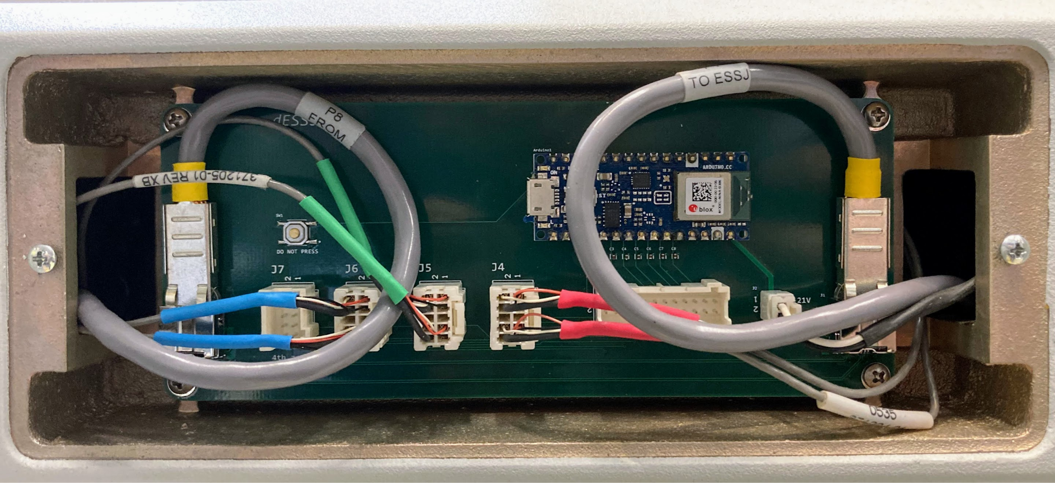
ESSJ
LVDS
Potentiometers (3 except ECM: 4)
Power
dESSJ
On the SUJ arms, remove ESSJ (red arrow, 4 places).
Replace with dESSJ and plug in cables.

